Slide 1


SAP OData Training
Day - 8.

Slide 2


Agenda Day - 8
CDS BOPF
Define Business Object
Nodes of Business Object
Flow of Scenario
CDS Annotations
Building BOPF Scenario
Development Flow & Artifact
Create Fiori App on BAS
Break
Meta Data Extension
Add Validation
Add Determination
Add Action
Trainer: Anubhav Oberoy

Slide 3

CDS BOPF
Introduction
The Business Object Processing Framework is an ABAP OO-based framework that provides a set of generic services and functionalities to speed up, standardize, and modularize your development. BOPF manages the entire life cycle of your business objects and covers all aspects of your business application development. Instead of expending effort for developing an application infrastructure, the developer can focus on the individual business logic. Using BOPF, you get the whole application infrastructure and integration of various components for free. This allows you to rapidly build applications on a stable and customer-proved infrastructure.
Trainer: Anubhav Oberoy

Slide 4
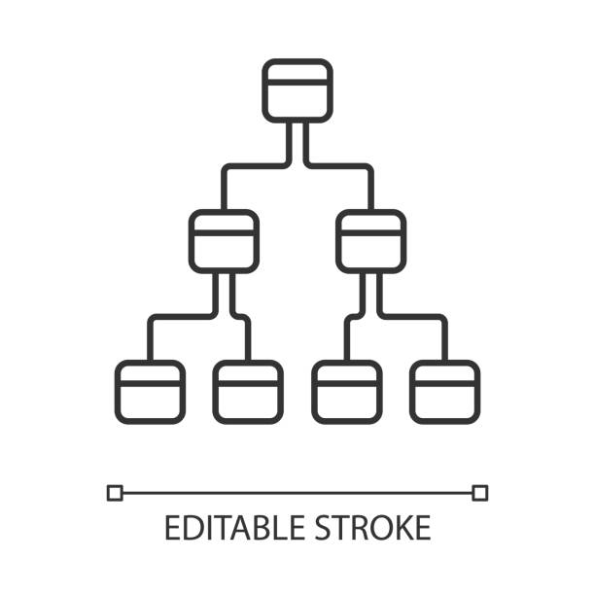
Business Object
The business objects are the basic units of the BOPF-based programming model. Business applications or processes operate on certain business objects.
A business object is represented as a hierarchical tree of nodes. A single node includes a set of semantically related business object data and the corresponding business logic.
On the technical level, each node is implemented with a regular Dictionary table, where each node instance corresponds to a single table entry (table rows).
Nodes, attributes, and alternative keys set up the data part of a business object. Again from a technical viewpoint, attributes form the columns of the table. A node serves as an anchor point for connecting the business logic of the business object.
For each node, several types of entities can be defined to form the specific business logic part of a business object.
Introduction
01
Software Innovation
02
Hardware Innovation
Trainer: Anubhav Oberoy

Slide 5
Node of Business Object
Node Entity ...is used...
Action
... to implement a service (operation or behavior) of a business object. An action is explicitly triggered by a service consumer, such as the user interface.
Determination
... to provide functions that are automatically executed as soon as certain trigger conditions are fulfilled. A determination is triggered internally due to changes made to the instance of a business object.
Validation
... to either validate whether a specific action can be executed on a specific node instance (action validations) or whether a set of node instances is consistent (consistency validations).
Query
... to search for business object instances that meet certain search criteria.
Authorization Check
... to provide an authorization concept for BO nodes (for their data and for the operations on their data).
Association
... to connect business object instances that are located on different nodes.
Introduction
01
Software Innovation
02
Trainer: Anubhav Oberoy

Slide 6
Flow of BOPF Scenario
Metadata Extension CDS View.
Consumption CDS View.
Introduction
Table – ZOFT_MEALS.
Draft Table - ZOFT_JUL_MEAL.
01
Software Innovation
ZOFT_JUL_MEAL
ZOFT_MEALS
ZMAR_CDS_BOPF
ZMAR_MED_BOPF
02
Hardware Innovation
Trainer: Anubhav Oberoy

Slide 7
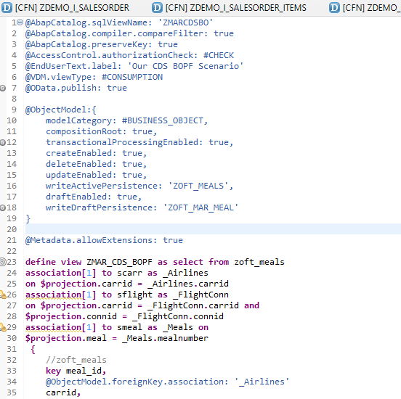
CDS Annotations
Access Control
VDM Annotation
OData Exposure
Transaction enabled
Draft enabled
Trainer: Anubhav Oberoy

Slide 8

Building BOPF Scenario
Exercise
CDS BOPF Scenario
Introduction
01
Software Innovation
02
Hardware Innovation
Trainer: Anubhav Oberoy

Slide 9
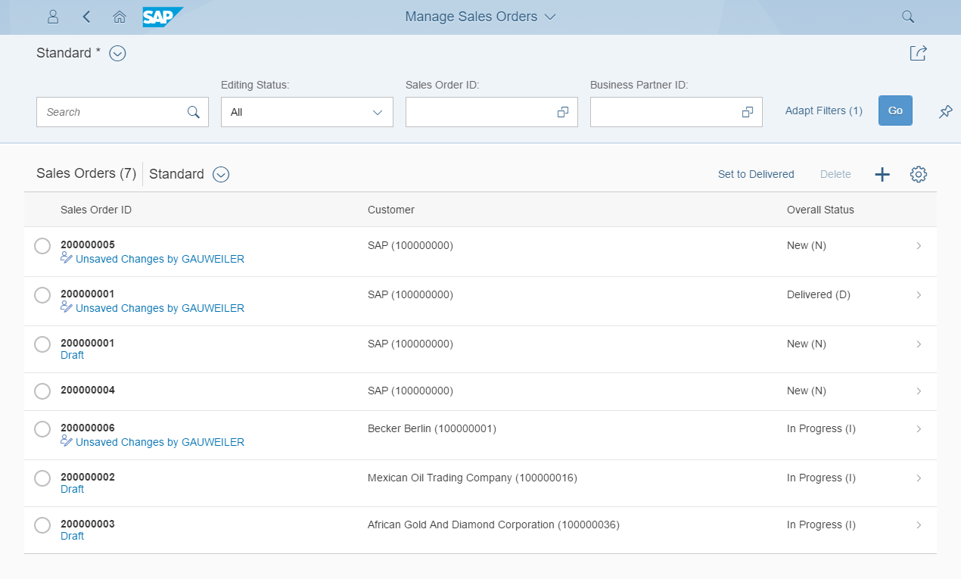
Development flow & Artifacts
BOPF (Business Object Processing Framework) is a framework for working with the BO (Business Objects). BO is a representation of a type of uniquely identifiable business entities described by a structural model, an internal process model, and one or more service interfaces.
consume
SAP Fiori Elements, …
OData Service
Consumption view
Consumption view
Introduction
Search Object(s)
Core Data Services
generate / publish
Subnode consumption view
Subnode consumption view
Subnode consumption view
Subnode consumption view
Metadata Extension
enrich
Data Definition
generate
BOPF Business Object
implement
Custom ABAP Business Logic
CDS metadata extensions can currently only be created for CDS views. A CDS metadata extension is a CDS object that is defined and transported in a separate CDS source code.
Draft table
Draft table
Database table
Draft table
Trainer: Anubhav Oberoy

Slide 10
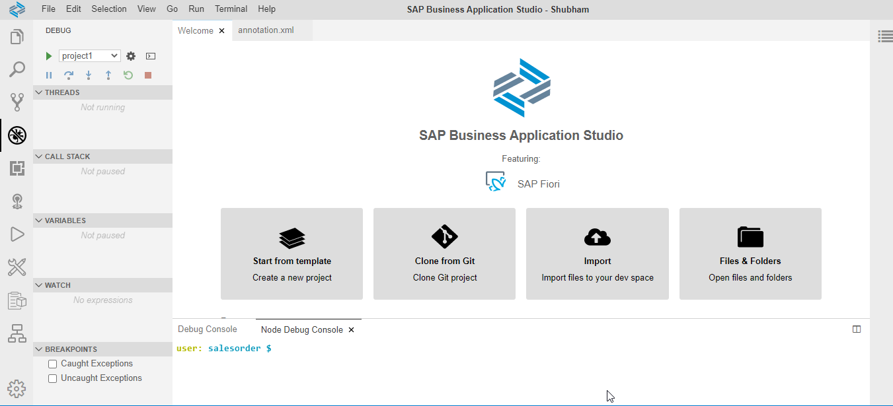
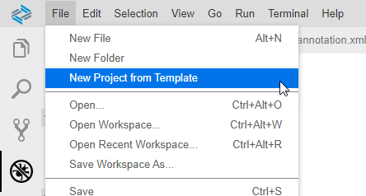
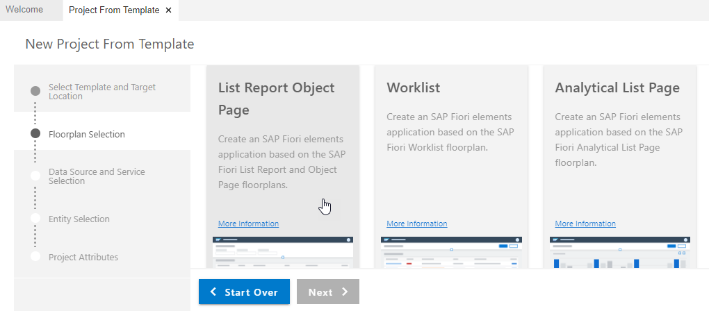
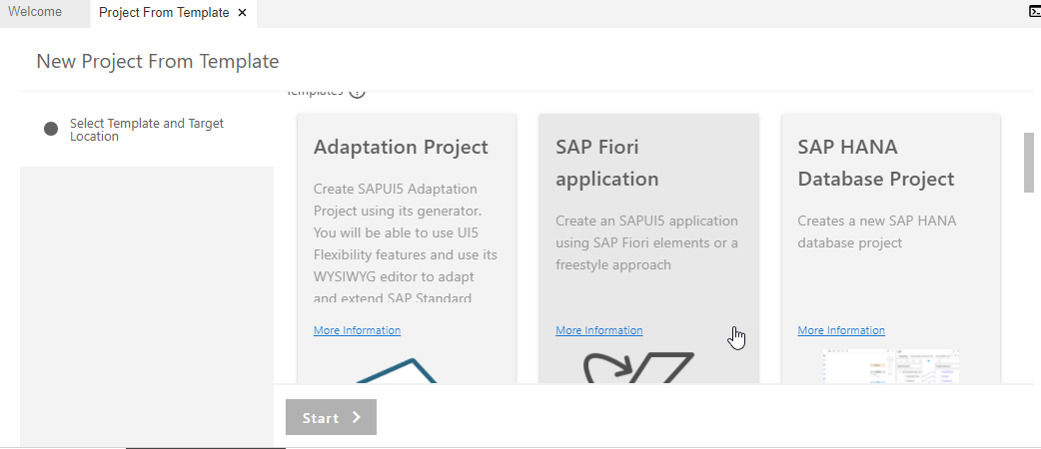
Create Fiori App with Template on BAS
Step 1. Open Business Application Studio.
Step 4. Choose List Report Object Page & Next.
Step 3. Click on SAP Fiori application & Next.
Trainer: Anubhav Oberoy

Slide 11
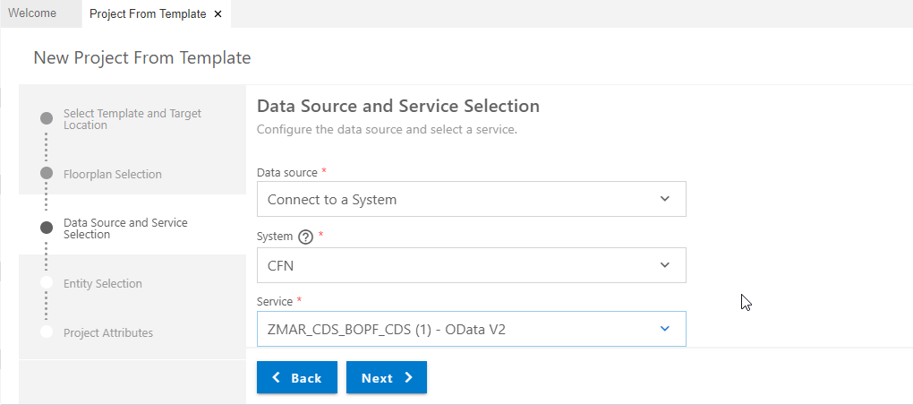
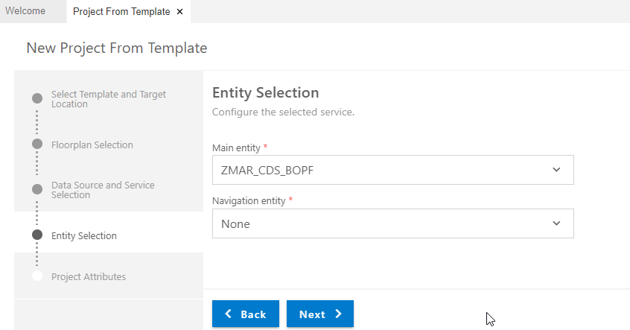
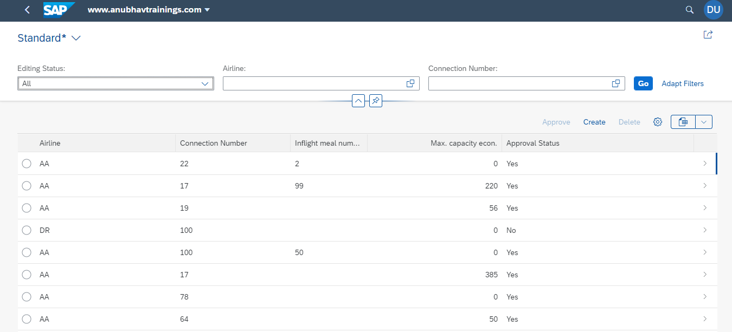
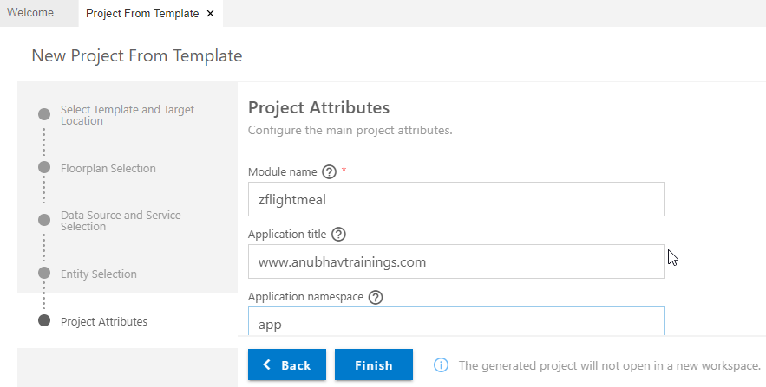
Create Fiori App with Template on BAS
Step 5. Enter Data Source & Select OData service.
Step 6. Entity Selection & Next.
Step 8. Run Project for Final output.
Step 7. Enter Project Attributes & Finish.
Trainer: Anubhav Oberoy

Slide 12

Break

Slide 13
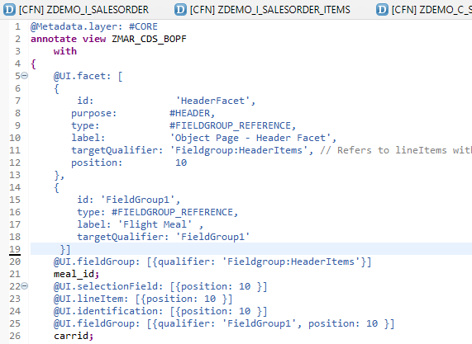
Meta Data Extension
A CDS metadata extension (MDE) extends a CDS entity with CDS annotations that are not defined in the CDS source code of the data definition. CDS metadata extensions can currently only be created for CDS views.
@Metadata.allowExtension: true
There can be several metadata extensions for one CDS entity. The following rules determine which metadata extension to use to evaluate the annotations:
Each metadata extension is assigned to a layer, such as branch, partner, or customer. The layer determines the priority of the evaluation.
A metadata extension can be joined to a CDS variant. The CDS variant can be specified during the evaluation of the annotations of a CDS entity to select the metadata extension.
Trainer: Anubhav Oberoy

Slide 14
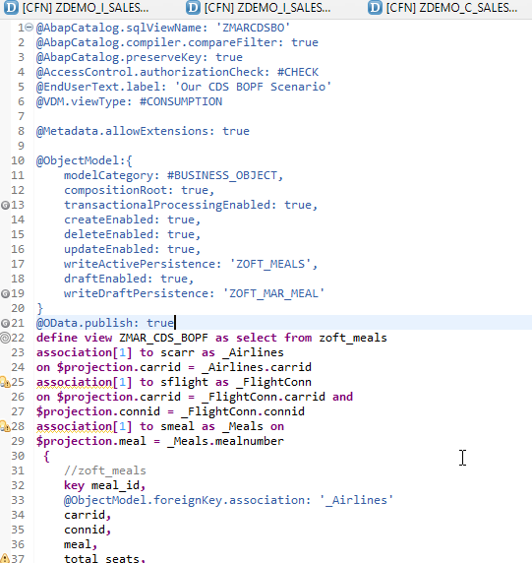
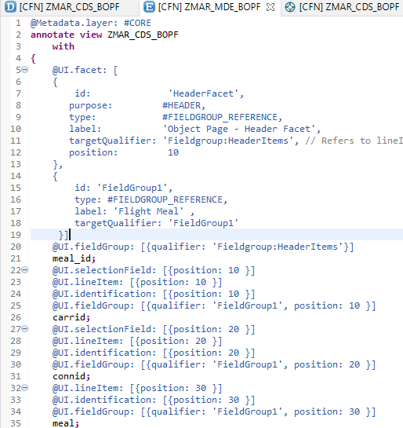
Transactional UX App with CDS & BOPF
Meta Data Annotation
Exercise
Meta Data CDS Code
Annotation for Filter
Line item Annotation
Trainer: Anubhav Oberoy

Slide 15
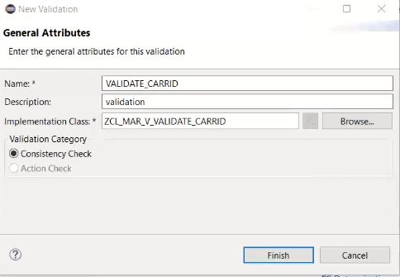
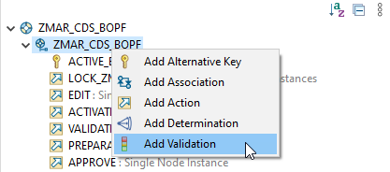
Validation
If this condition is fulfilled, the BOPF runtime automatically executes the validation. We call this implicit validation. Implicit validations are executed after each modification of node data, depending on the configured request nodes. A validation is an entity of a business object node that is triggered in certain situations to check various aspects of a given set of node instances. It is used used to validate whether a set of node instances is consistent.
Right Click on Business Object and Add Validation
Exercise
Implementing Validation
Trainer: Anubhav Oberoy

Slide 16
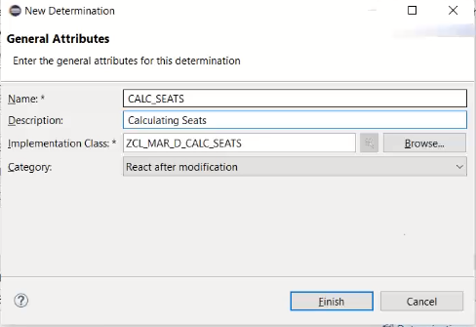
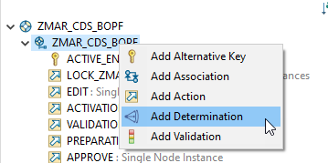
Determination
The Determination, change of business objects, such as saving, is the logic that moves when certain conditions are met.
Introduction
Right Click on Business Object and Add Determination
Exercise
Implementing Determination
Trainer: Anubhav Oberoy

Slide 17
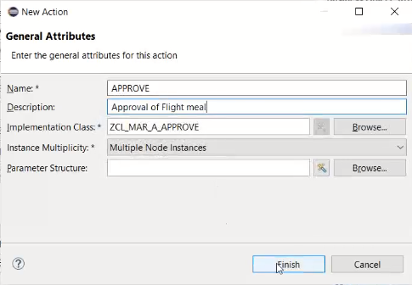
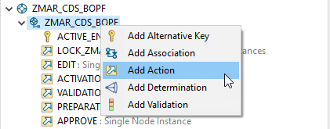
Action
Are the operations which are non-standard for a business object. Using these actions, we can also perform the CRUD with the help of BO.
The BOPF framework assigns the new action to the business object node and creates an action class that implements the BOPF action interface /BOBF/IF_FRW_ACTION .
Introduction
Right Click on Business Object and Add Action
Exercise
Implementing Action Code
Trainer: Anubhav Oberoy

Slide 18
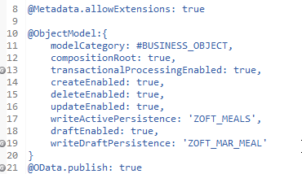
Draft Functionality
In SAP Fiori, drafts are used as follows: To keep unsaved changes if an editing activity is interrupted, allowing users to resume editing later. ... As a locking mechanism to prevent multiple users from editing the same object concurrently, and to make users aware when there are unsaved changes by another user.
Drafts are used as follows:
To keep unsaved changes if an editing activity is interrupted, allowing users to resume editing later.
To prevent data loss if an app terminates unexpectedly.
As a locking mechanism to prevent multiple users from editing the same object concurrently, and to make users aware when there are unsaved changes by another user.
Annotation for Draft Functionality
Trainer: Anubhav Oberoy

Slide 19

Summarize
End of Day 8

Slide 20

Questions

Slide 21

ANUBHAV OBEROY
www.anubhavtrainings.com
THANK YOU
“You can never leave footprints that last if you are always walking on tiptoe.”
Notes:
https://pixabay.com/photos/men-employees-suit-work-greeting-1979261/

Slide 22


We’re committed to empower you to be
Most Desirable Resource
through powerful training solutions.
We build the workforce of the future.
250+
Corporate Clients
30,000+
Learners Trained
25000+
Learners Placed
FREE WEBINARS
Sign up for free webinars with industry experts every fortnight!
Enroll Now!
Contact us today!
https://anubhavtrainings.com/

Slide 23




More from AnubhavTrainings.com

